Slide 1
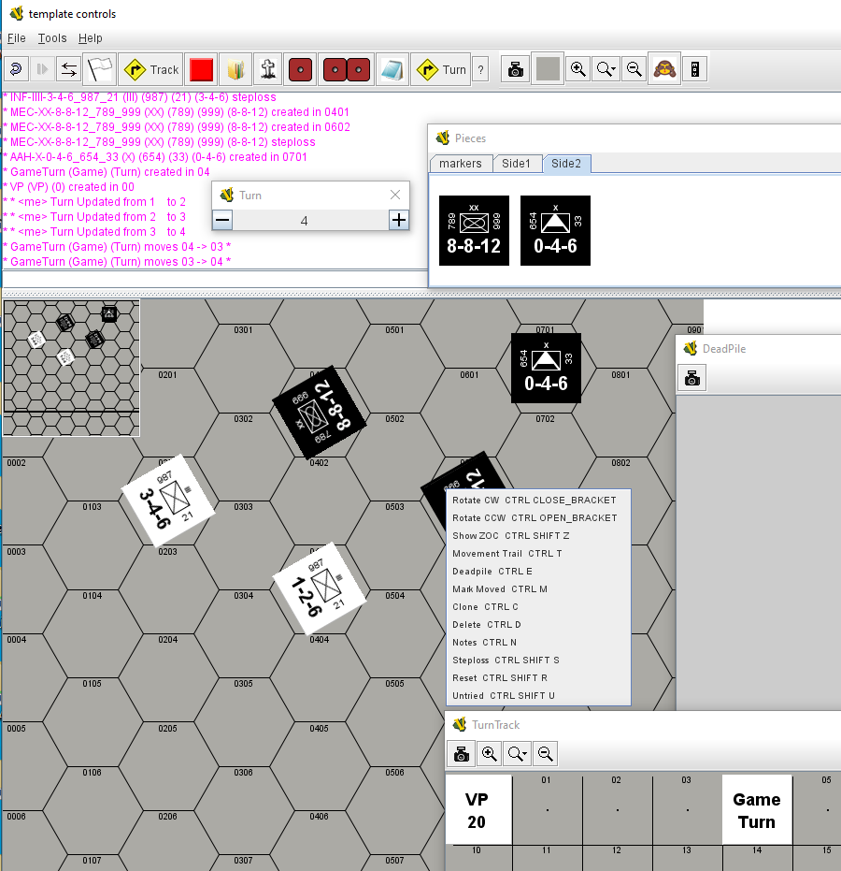


Vassal Hex and Counters Template
Introduction and Guide
John Edwards
www.simpubs.com
jzedward

Slide 2
Vassal Hex and Counters Template
Pieces
Images
Traits
Prototypes
Maps
Main Map
Deadpile
Turn Track
What Remains
Charts
Help
Icons
Introduction and Guide
John Edwards
jzedward

Slide 3

Pieces: Images Traits & Prototypes
Pieces
Images
Traits
Prototypes
sym-MEC-black
size
parent
id
Introduction and Guide
John Edwards
jzedward
8-8-12
counter-black

Slide 4
Pieces: Images Traits & Prototypes
MEC
size
parent
id
8-8-12
background

Slide 5
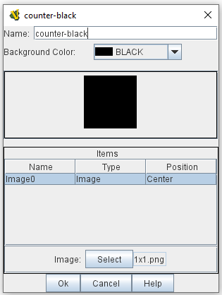
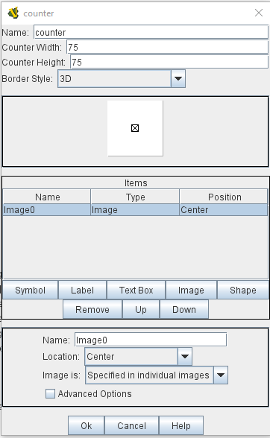
Vassal Hex and Counters Template
Pieces
Game Piece Image Definitions
Game Piece Layouts
Counter
counter-black
Introduction and Guide
John Edwards
jzedward

Slide 6
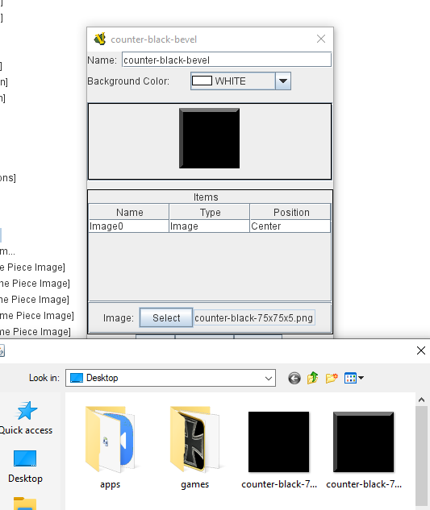

Vassal Hex and Counters Template
BONUS! Bevelled
Game Piece Layouts
Counter
counter-black-bevel
C:\> convert –raise 5 counter-black-75x75.png counter-black-75x75x5.png
Introduction and Guide
John Edwards
jzedward

Slide 7
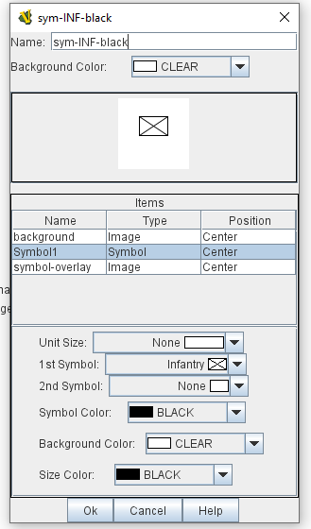
Vassal Hex and Counters Template
Pieces
Game Piece Image Definitions
Game Piece Layouts
Symbol
sym-INF-black
Introduction and Guide
John Edwards
jzedward

Slide 8
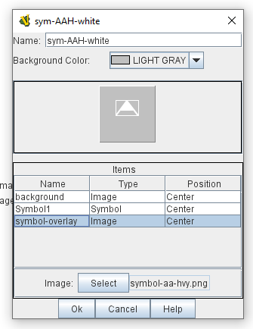
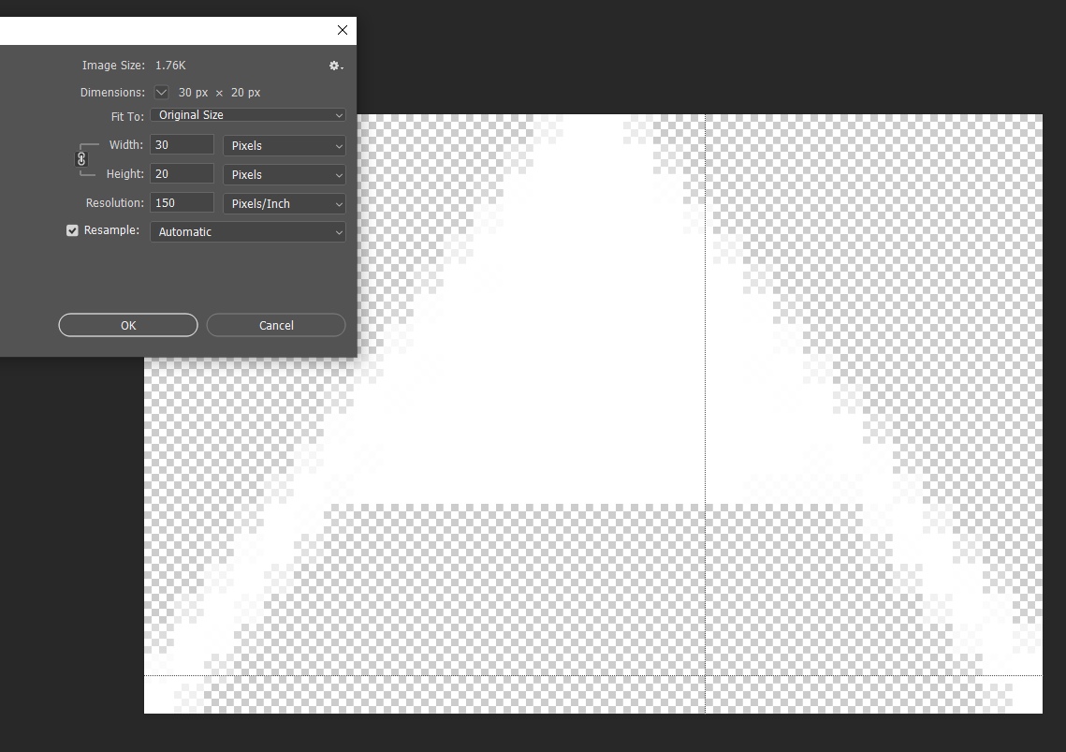
Vassal Hex and Counters Template
BONUS! Overlay
Game Piece Image Definitions
Game Piece Layouts
Symbol
sym-AAH-white (Heavy Anti-Air)
[changed to grey background for illustration]
add an image overlay to a 20x30 symbol
Introduction and Guide
John Edwards
jzedward

Slide 9
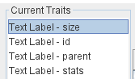
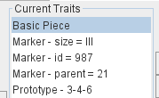
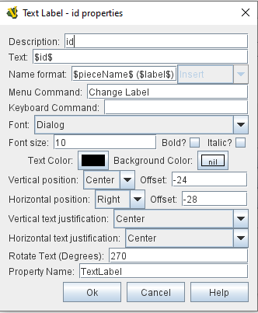
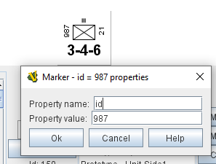
Vassal Hex and Counters Template
Pieces
Traits
Markers
Text Labels
Other Traits
Introduction and Guide
John Edwards
jzedward

Slide 10
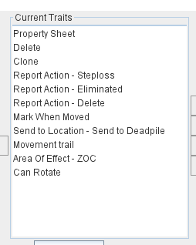
Vassal Hex and Counters Template
Pieces
Traits
Markers
Text Labels
Other Traits
Introduction and Guide
John Edwards
jzedward

Slide 11
Vassal Hex and Counters Template
Pieces
Protoypes
Counter
Basic playing piece traits, delete, clone, report etc
Unit-Side2
Text labels and side
sym-MEC-white
Symbol layer
8-8-12
Sets value of stats, with flip for step reduction
Introduction and Guide
John Edwards
jzedward

Slide 12
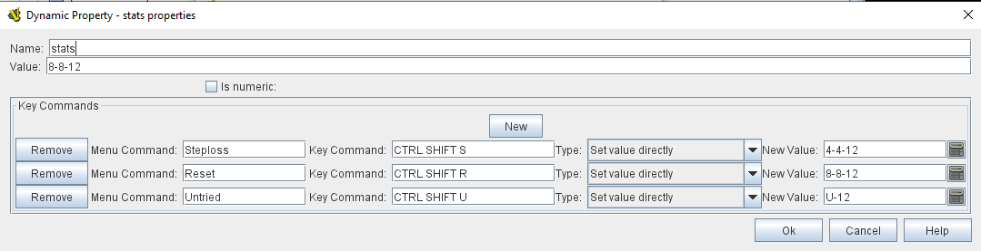
Vassal Hex and Counters Template
Pieces
Protoypes
8-8-12
Basic stats 8-8-12, reduced 4-4-12
Ctrl-shift-s for steploss
Option for ‘untried’ U-12
Introduction and Guide
John Edwards
jzedward

Slide 13
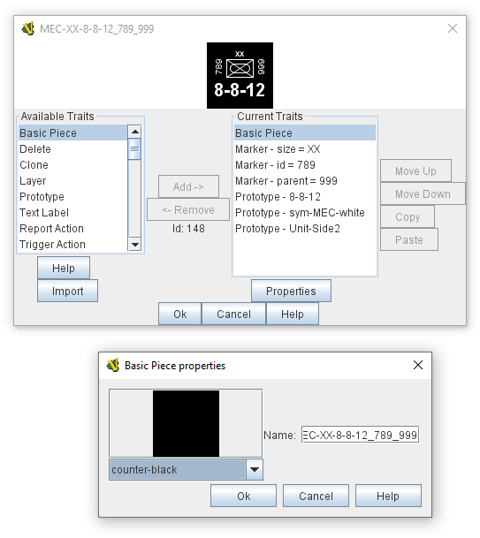
Vassal Hex and Counters Template
Pieces
Game Piece Palette
Pieces
Introduction and Guide
John Edwards
jzedward

Slide 14
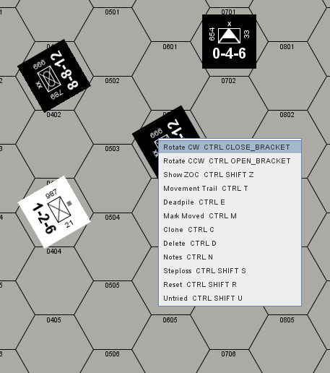
Vassal Hex and Counters Template
Pieces
The finished article
Introduction and Guide
John Edwards
jzedward

Slide 15
Vassal Hex and Counters Template
Pieces
Why is this so complicated?
It is simple to have an image of a counter eg with a symbol, but many images need to be maintained of every combination
Multiple, reusable prototypes make maintenance easy
Can be reused on many different games
With tech knowledge, counters *can* be quickly added editing the buildfile
Introduction and Guide
John Edwards
jzedward

Slide 16
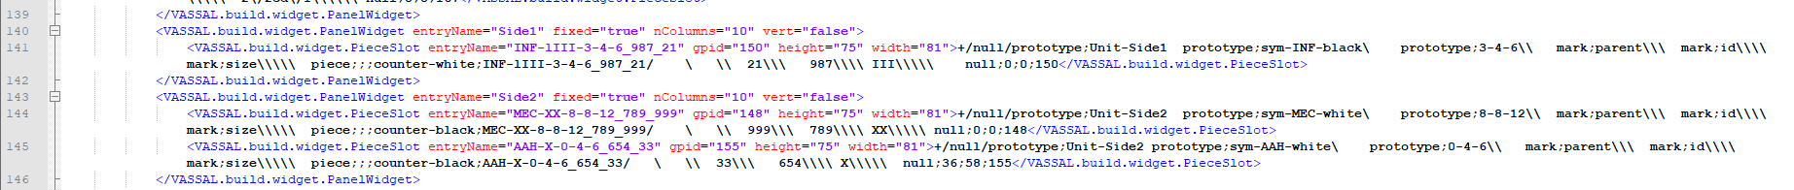
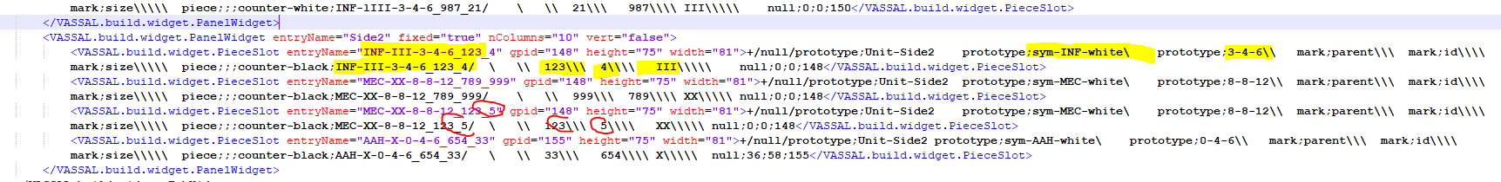
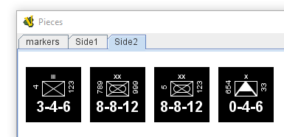
VassaCounters Template
Advanced - WARNING
Editing the buildfile
This is the counter definition
Copy the line(s) for a counter and edit the references
Introduction and Guide
John Edwards
jzedward

Slide 17
Vassal Hex and Counters Template
Pieces
Images
Traits
Prototypes
Maps
Main Map
Deadpile
Turn Track
What Remains
Charts
Help
Icons
Introduction and Guide
John Edwards
jzedward

Slide 18
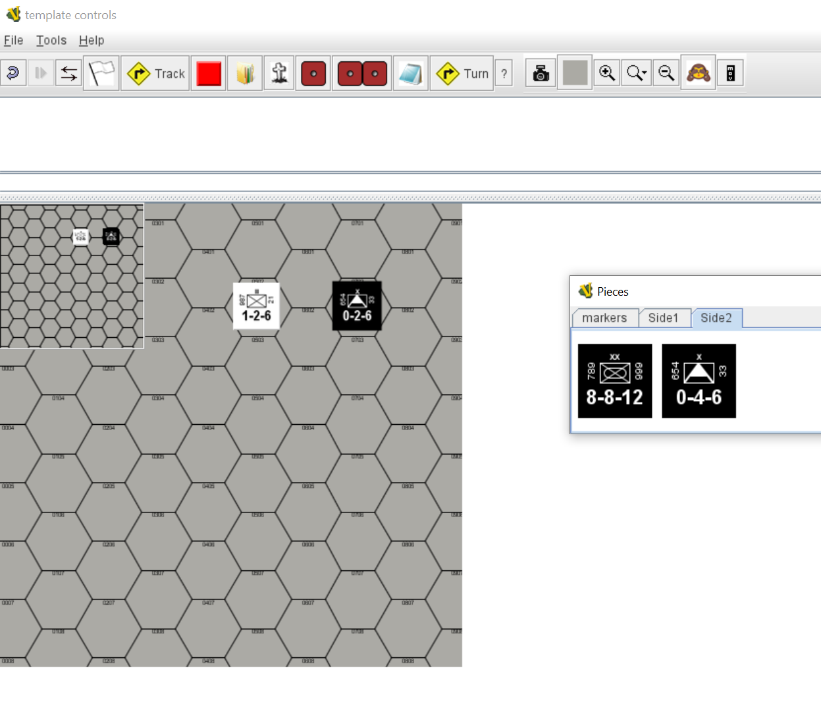
Vassal Hex and Counters Template
Maps
Main Map
Deadpile
Turn Track
Introduction and Guide
John Edwards
jzedward

Slide 19
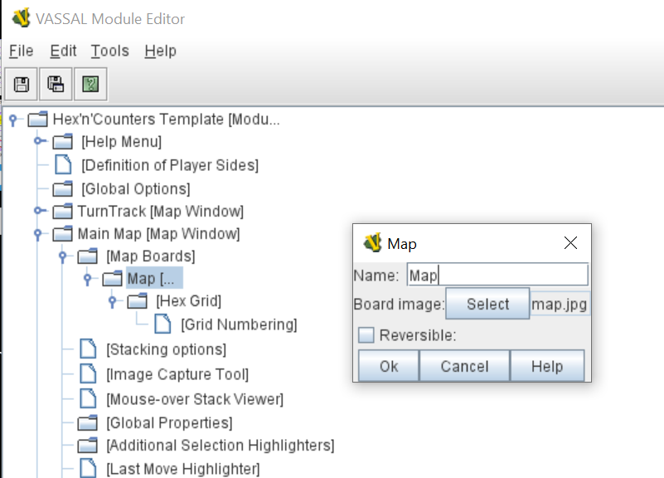
Vassal Hex and Counters Template
Maps
Main Map
Introduction and Guide
John Edwards
jzedward

Slide 20
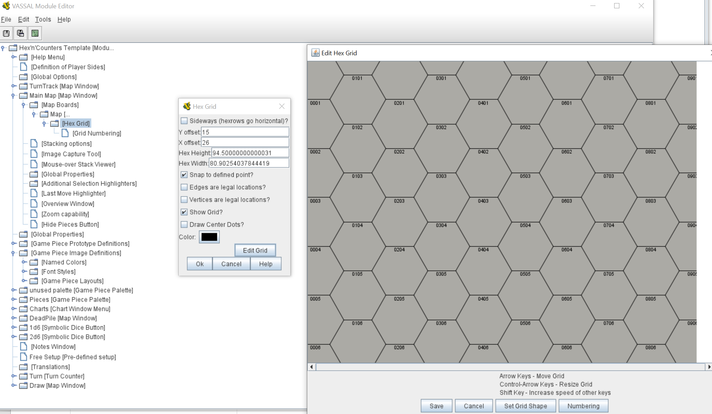
Vassal Hex and Counters Template
Maps
Main Map - Hexgrid
Introduction and Guide
John Edwards
jzedward

Slide 21
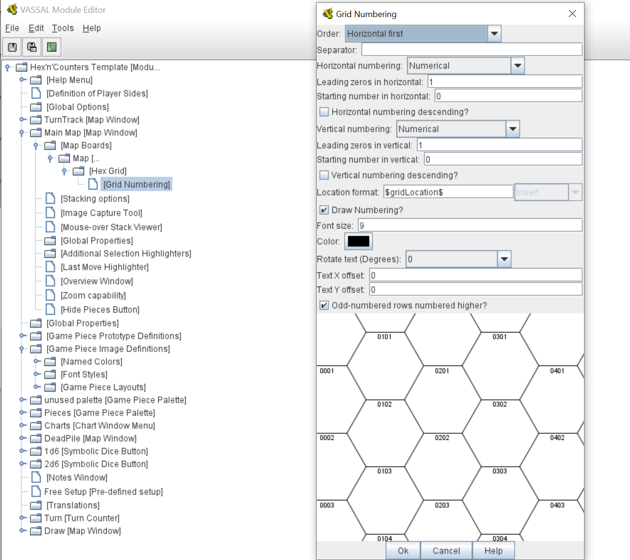
Vassal Hex and Counters Template
Maps
Main Map – Grid Numbering
Introduction and Guide
John Edwards
jzedward

Slide 22
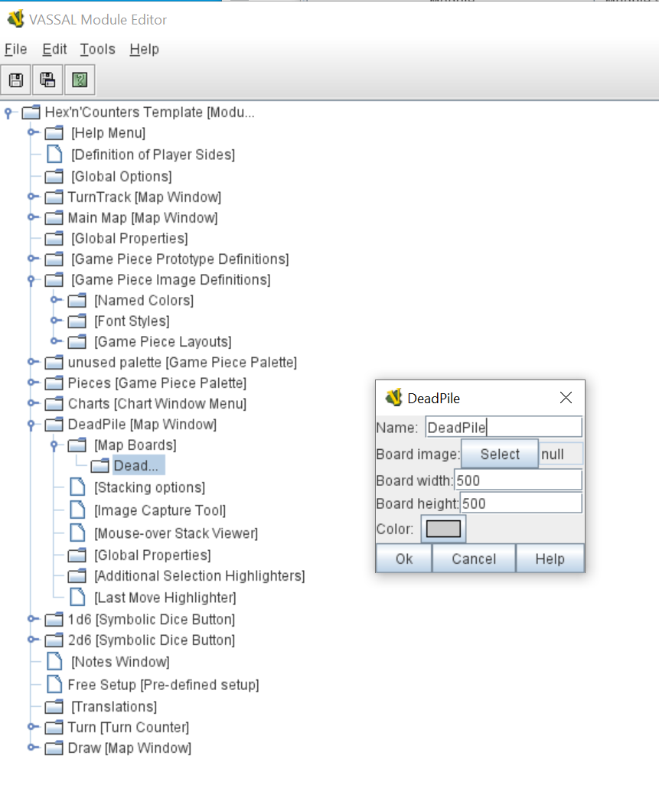
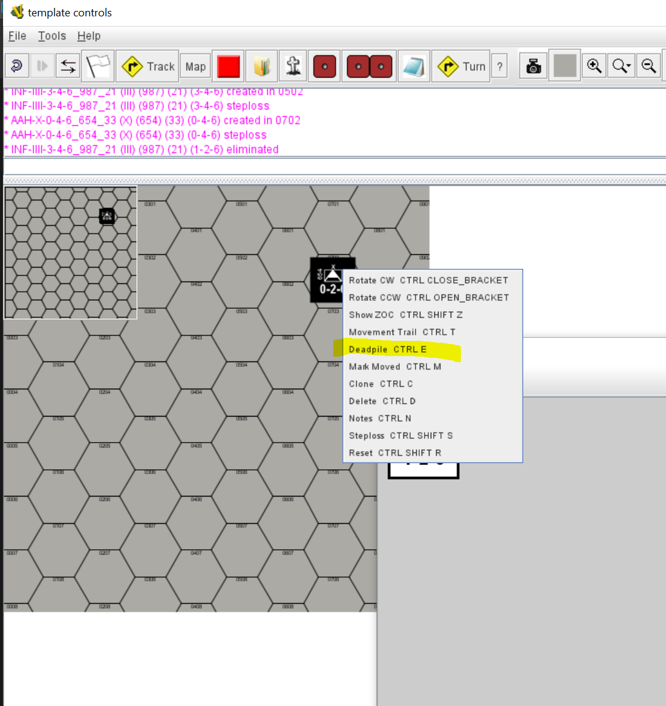
Vassal Hex and Counters Template
Maps
Deadpile
Introduction and Guide
John Edwards
jzedward

Slide 23
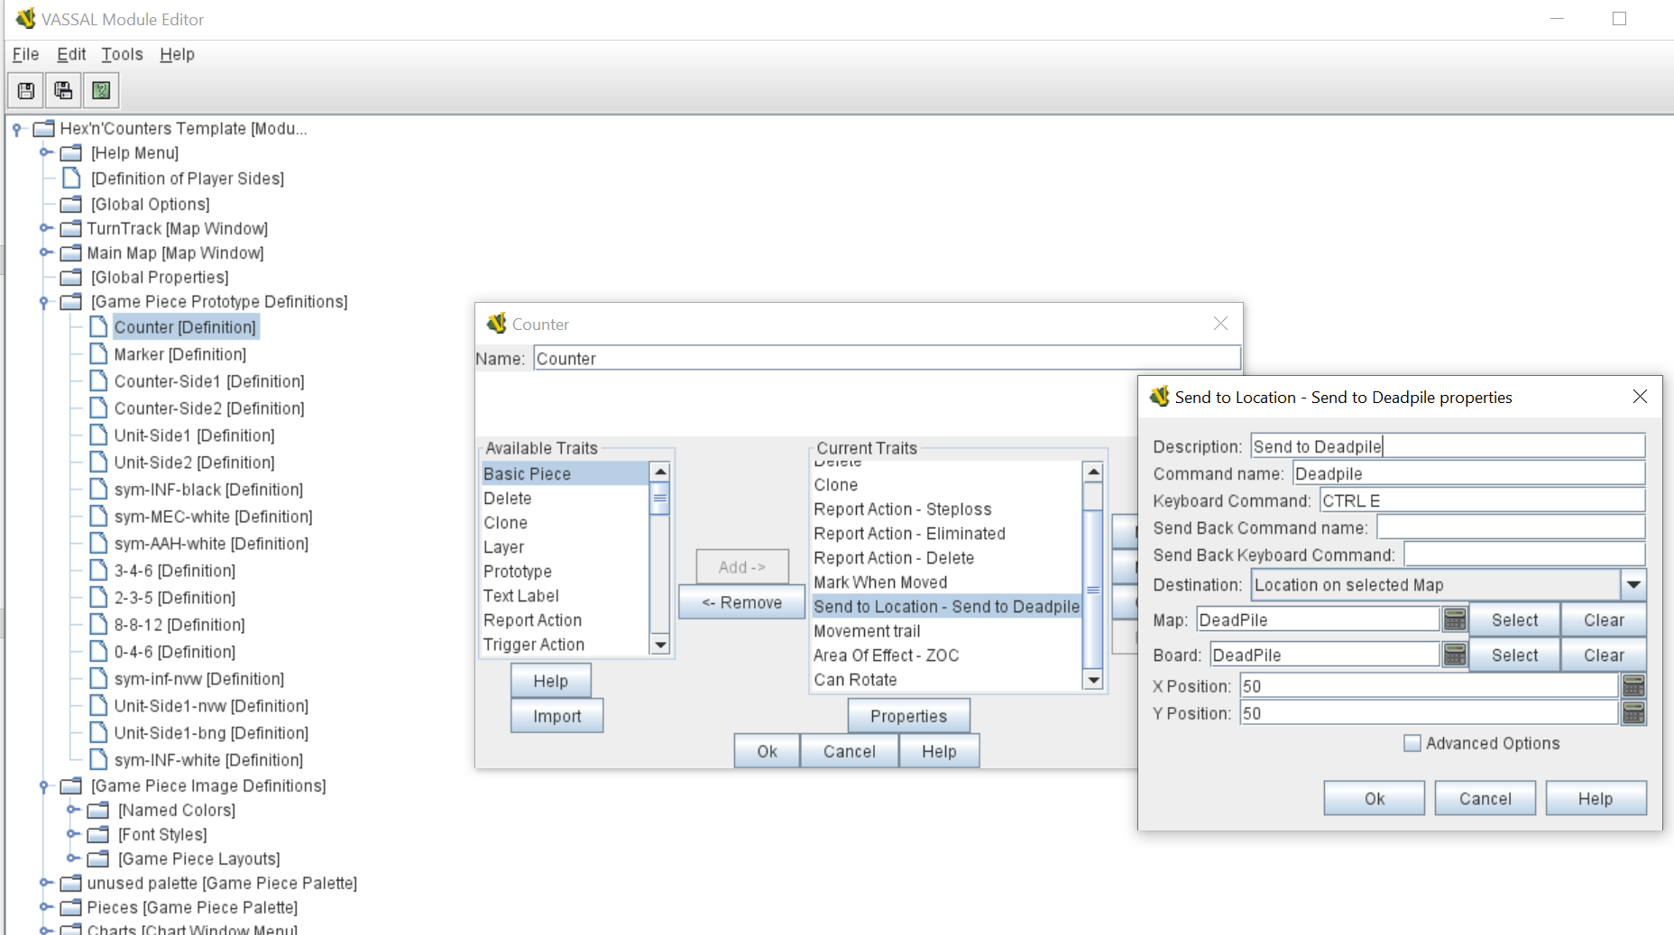
Vassal Hex and Counters Template
Maps
Deadpile
Introduction and Guide
John Edwards
jzedward

Slide 24
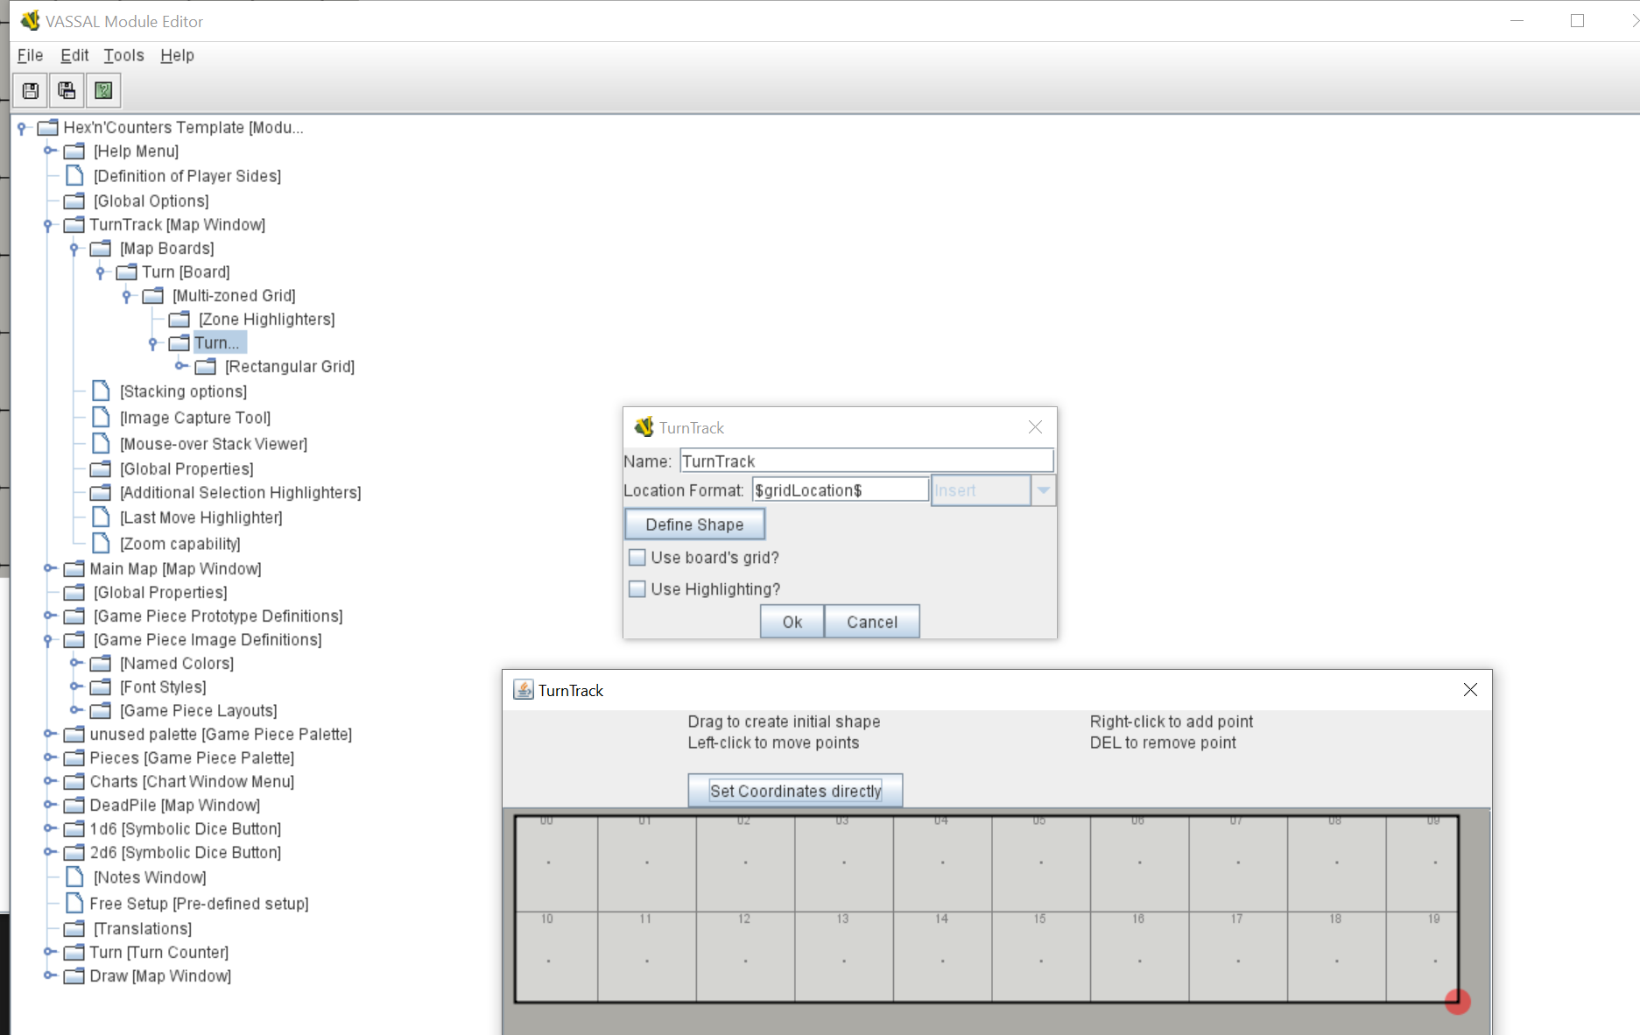
Vassal Hex and Counters Template
Maps
Turn Track
Introduction and Guide
John Edwards
jzedward

Slide 25
Vassal Hex and Counters Template
Pieces
Images
Traits
Prototypes
Maps
Main Map
Deadpile
Turn Track
What Remains
Charts
Help
Icons
Introduction and Guide
John Edwards
jzedward

Slide 26
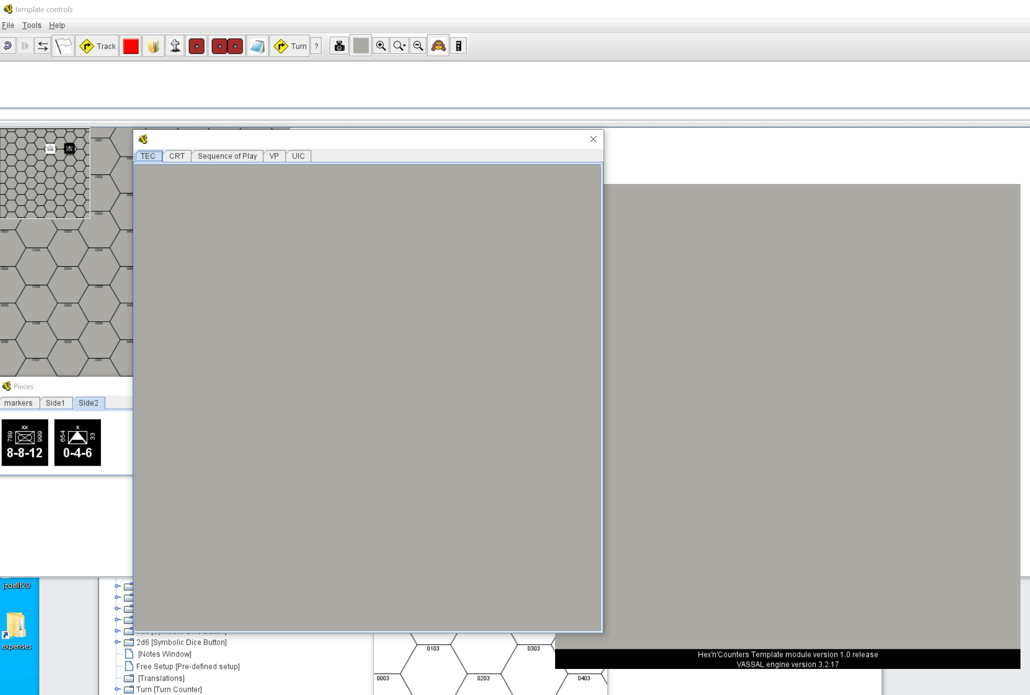
Vassal Hex and Counters Template
Leftovers
Charts
Help
Icons
Introduction and Guide
John Edwards
jzedward

Slide 27
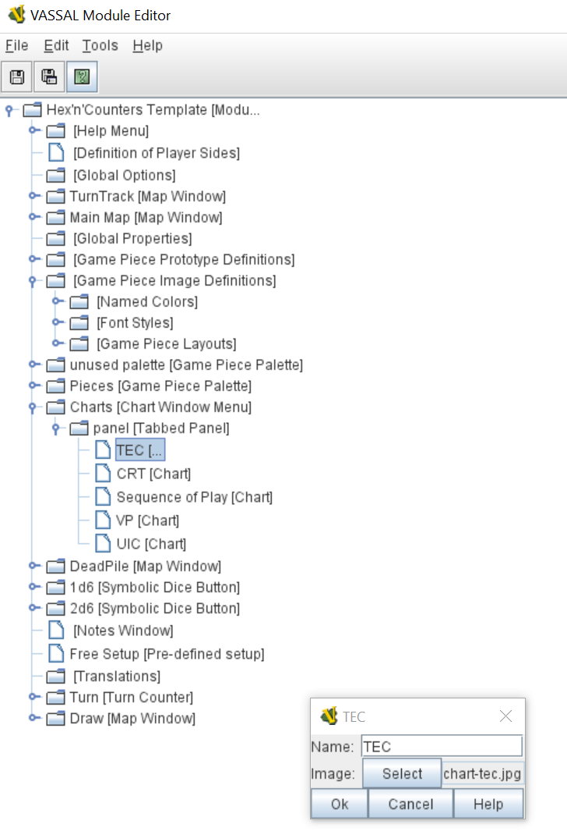
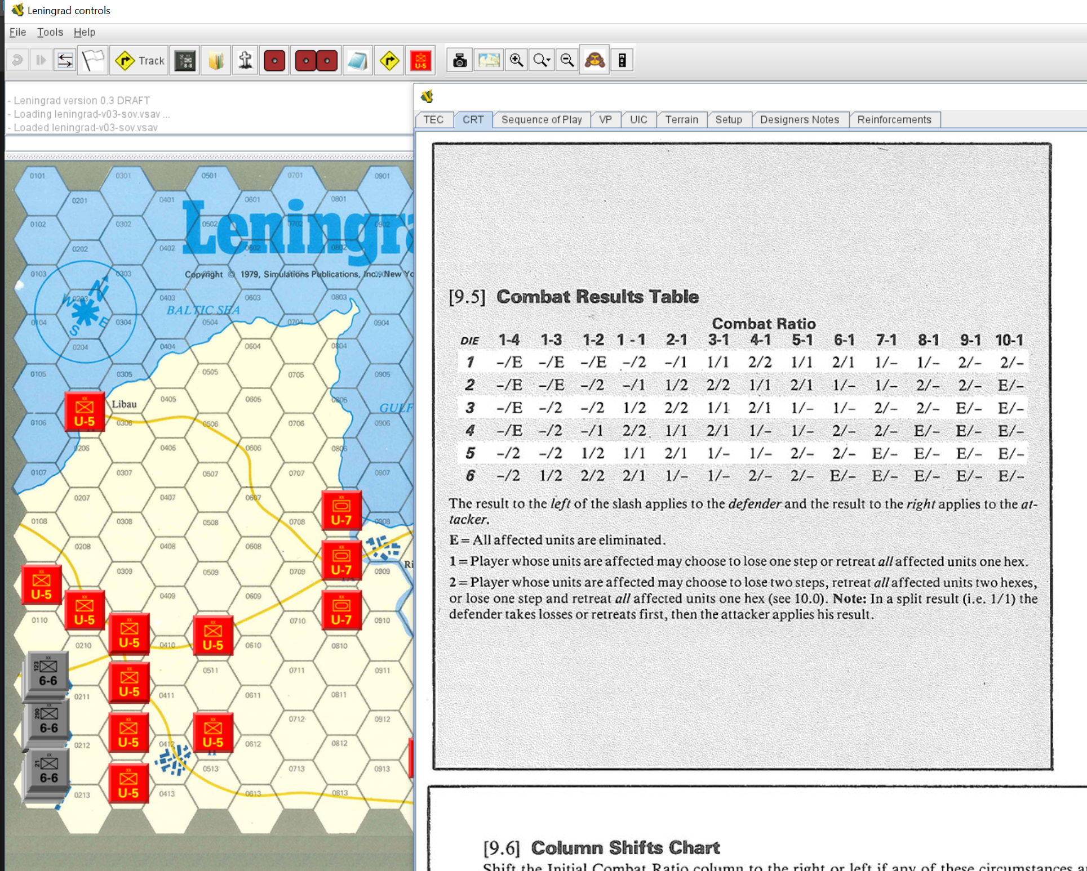
Vassal Hex and Counters Template
Leftovers
Charts
Introduction and Guide
John Edwards
jzedward

Slide 28
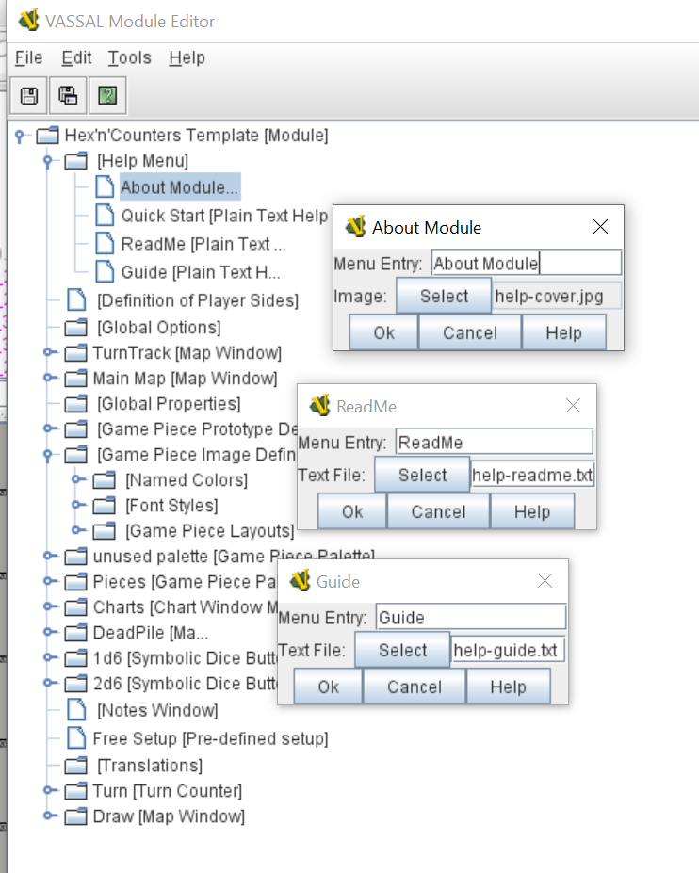
Vassal Hex and Counters Template
Leftovers
Help
Introduction and Guide
John Edwards
jzedward

Slide 29
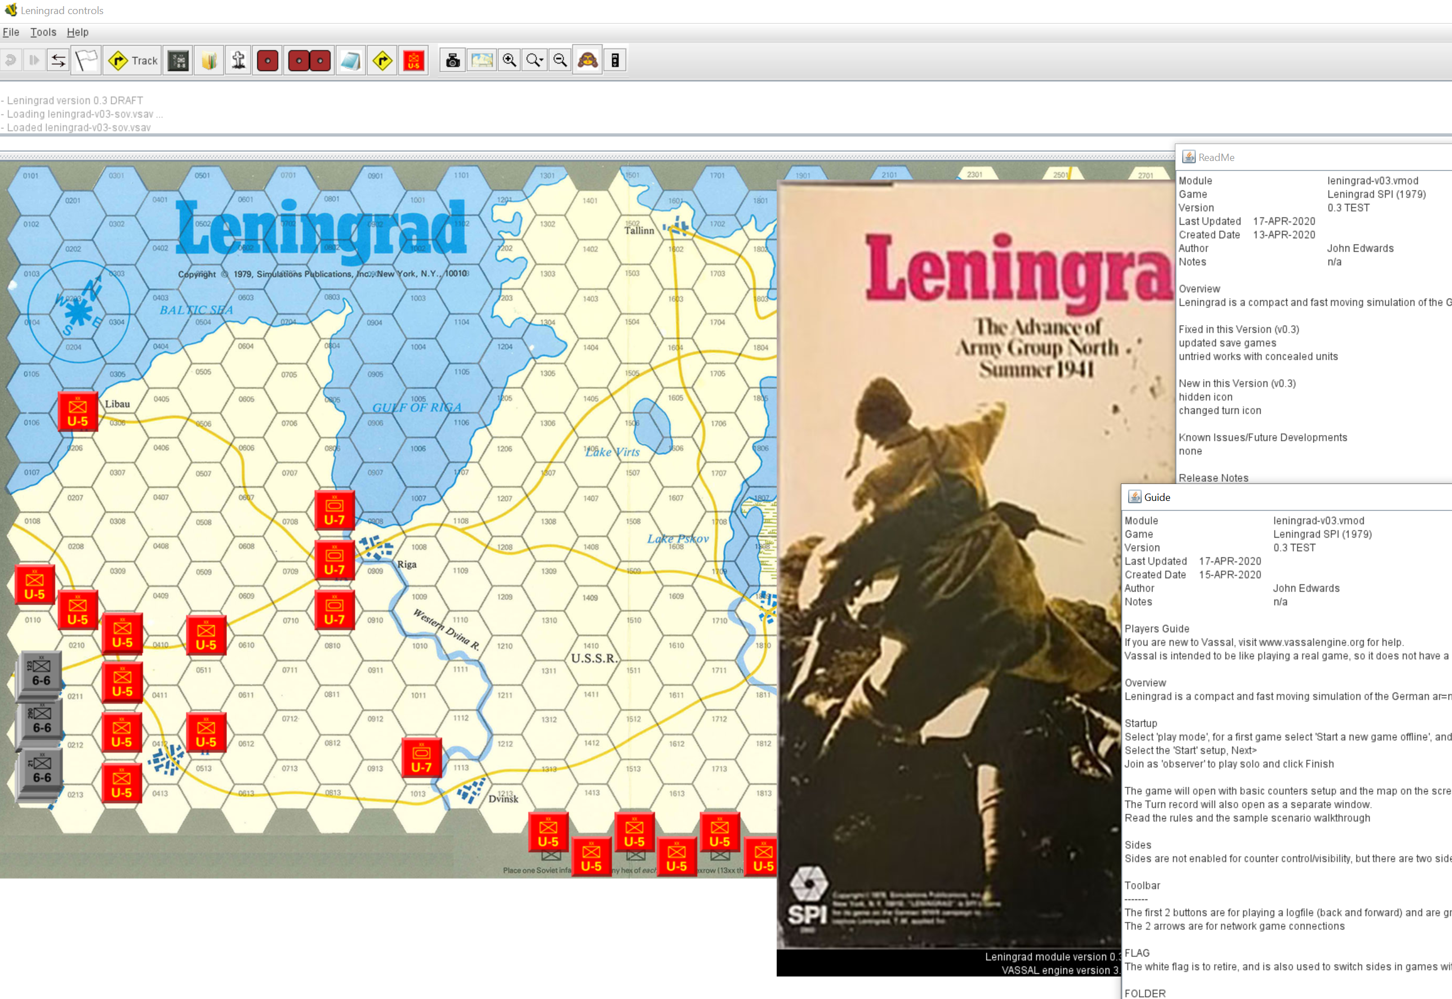
Vassal Hex and Counters Template
Leftovers
Help
Introduction and Guide
John Edwards
jzedward

Slide 30
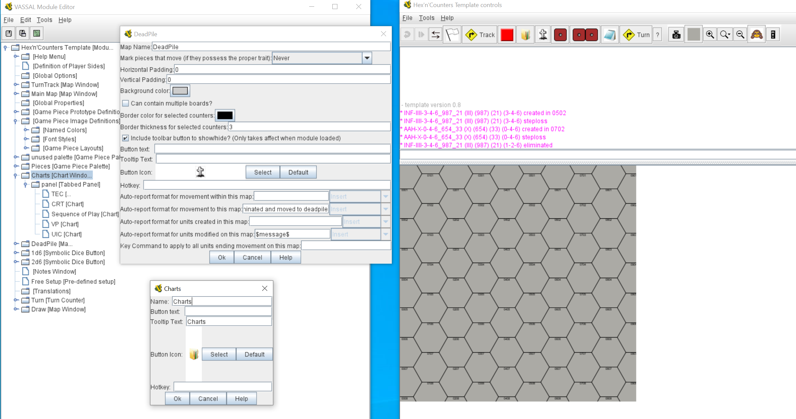
Vassal Hex and Counters Template
Leftovers
Icons
Introduction and Guide
John Edwards
jzedward

Slide 31
Vassal Hex and Counters Template
Introduction and Guide
John Edwards
www.simpubs.com
jzedward

